Slide 1

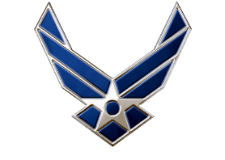
BEAST AAR
Air Force ROTC Detachment 842
The University of Texas at San Antonio
C/1st Lt Vallor
C/1st Lt Rodriguez
18 Apr 2024

Slide 2


Overview
What Went Well?
What Could be Improved?
Additional Comments
Air Force ROTC Detachment 842 • We Build Exceptional Officers • The University of Texas at San Antonio

Slide 3
What Went Well?
Emulate a proper day in Field Training
Instruction-based learning
NCOs
Smooth transition between rotations
all teams had all information
Delegating tasks to other detachments
PA
Snacks/Drinks
Air Force ROTC Detachment 842 • We Build Exceptional Officers • The University of Texas at San Antonio

Slide 4
What Could be Improved?
Finalizing initial plans earlier in the planning phase
locations
scenarios
Making sure time is not wasted
anticipate time based on number of cadets
Scenario debriefing
constructive
organized
Air Force ROTC Detachment 842 • We Build Exceptional Officers • The University of Texas at San Antonio

Slide 5
Additional Comments
OpFor behavior
cadets should be properly educated on the role
Firearm Safety and Etiquette
Updating the Name
Air Force ROTC Detachment 842 • We Build Exceptional Officers • The University of Texas at San Antonio

Slide 6
Summary
What Went Well?
What Could be Improved?
Additional Comments
Air Force ROTC Detachment 842 • We Build Exceptional Officers • The University of Texas at San Antonio

Slide 7
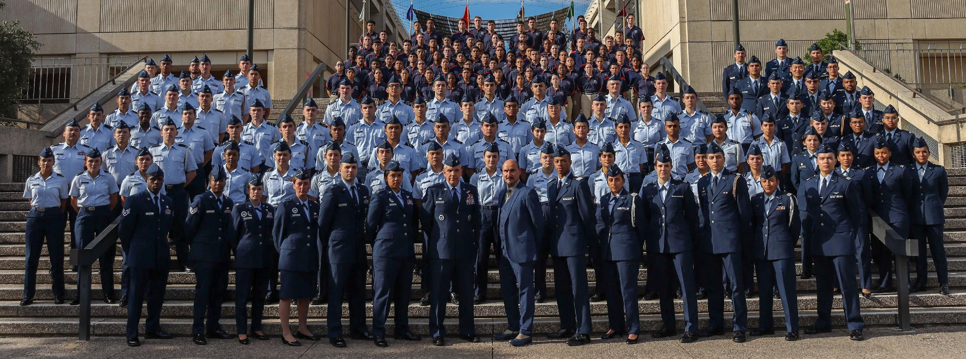
Air Force ROTC Detachment 842
The University of Texas at San Antonio
Det 842 – Best in Blue

